Slide 1

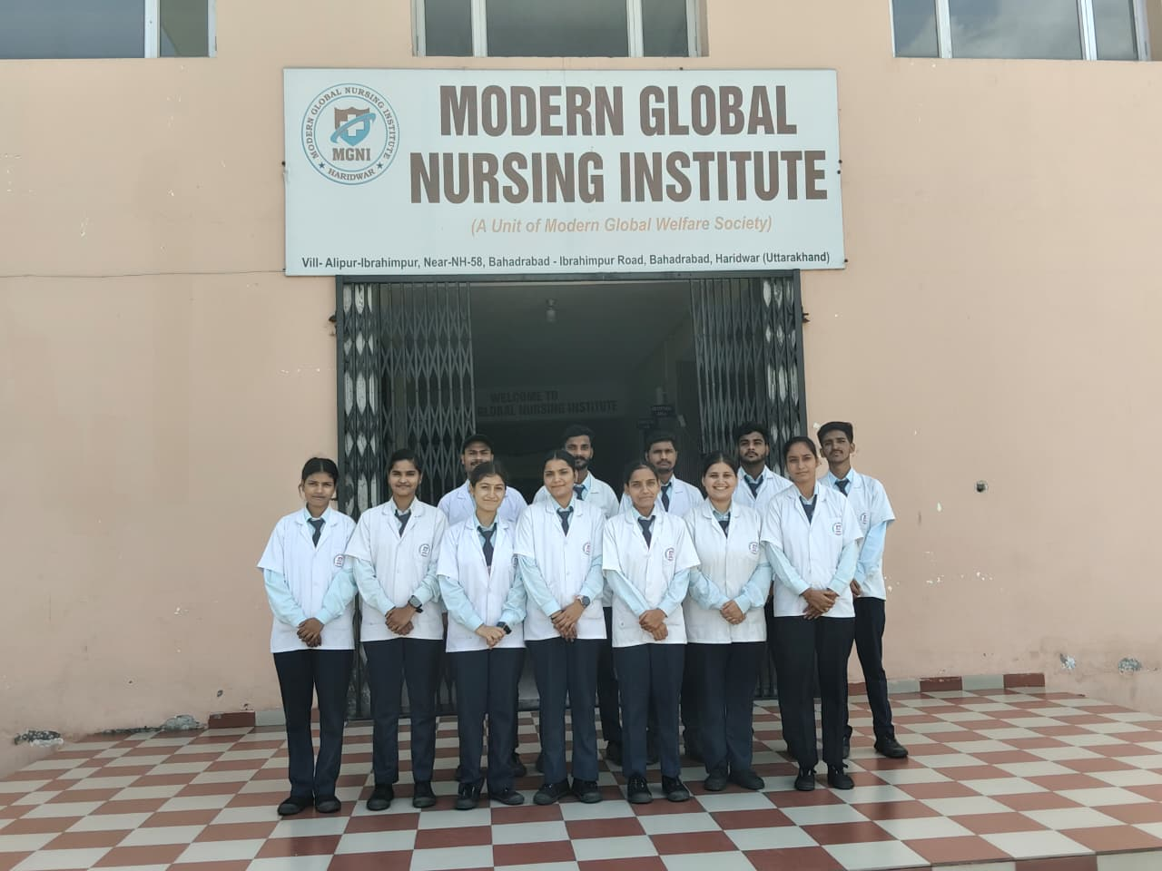
MODERN GLOBAL NURSING INSTITUTE
(A Unit of Modern Global Welfare Society)
Village-Alipur- Ibrahimpur, Near-NH-58, Bahadrabad- Ibrahimpur Road, Bahadrabad, Haridwar

Slide 2
MODERN GLOBAL NURSING INSTITUTE
(A Unit of Modern Global Welfare Society)
Village-Alipur- Ibrahimpur, Near-NH-58, Bahadrabad-Ibrahimpur Road, Bahadrabad, Haridwar
VISION
To be recognized as a leading model of institution offering excellence in quality of nursing education to promote research activities and turning out intellectually enlightened, morally upright, emotionally balanced and socially committed health care professionals.

Slide 3
MISSION
To enhances the individual student to become a good leader and self-motivator in professional practice of nursing.
To create, empowered, committed, compassionate and skilful healthcare providers who make a difference in building a healthy family, community and nation.
To promote learning that stimulates learners to reach their full potential through out their life.
To foster innovative research that will benefit the humanity and improve the nursing standards.

Slide 4
COURSE OFFERED :-
G.N.M. (3 YEAR )
BASIC B.Sc. NURSING (4 YEARS)
POST BASIC B.Sc. NURSING (2 YEARS)
Approved by :- Uttarakhand Government &
Uttarakhand Nurses & Midwives Council, Dehradun
Affiliated to:- Hemwati Nandan Bahuguna Medical Education University, Dehradun & Uttarakhand State Medical Faculty, Dehradun

Slide 5
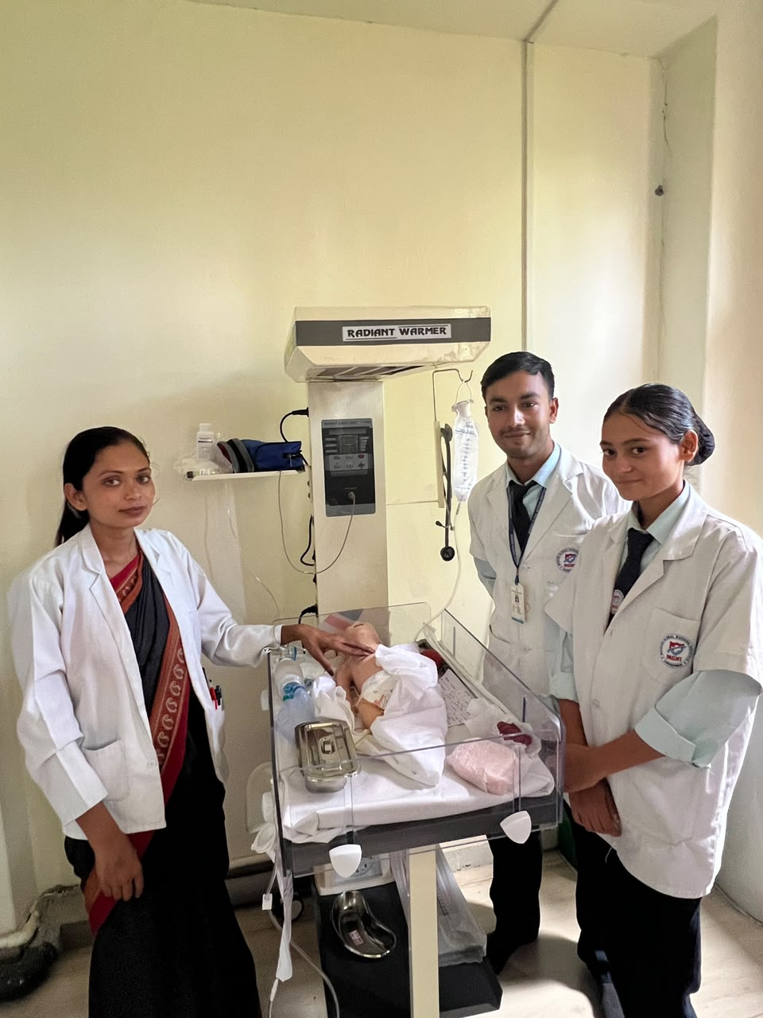
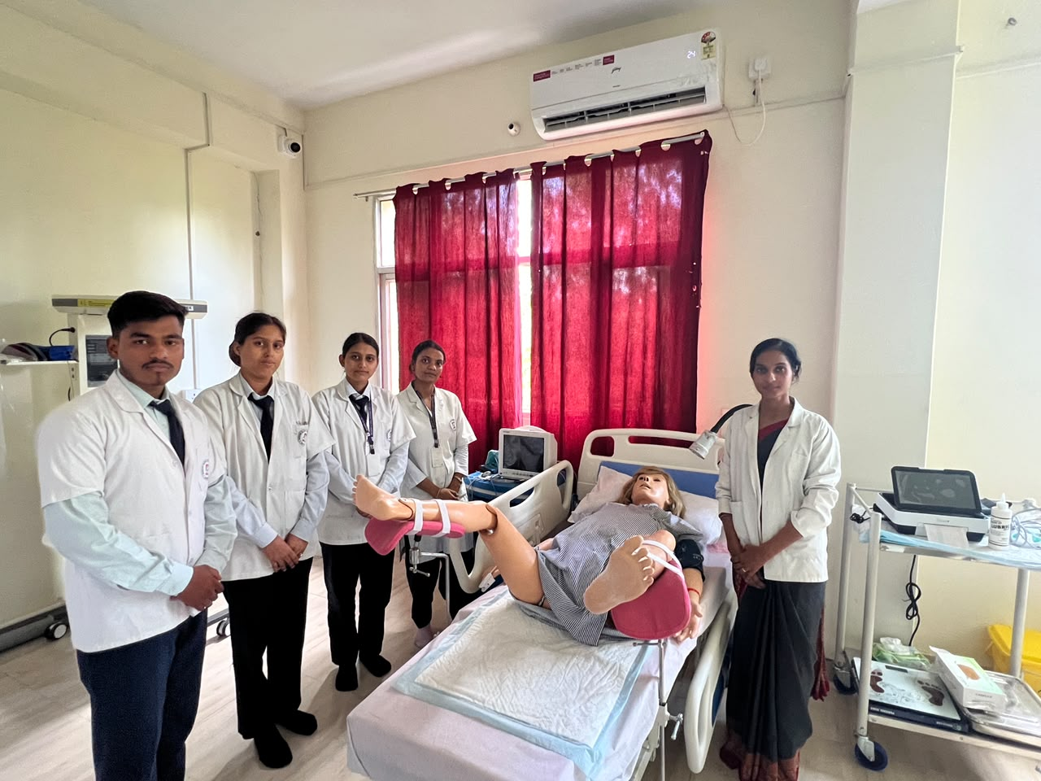
PEDIATRIC LAB & OBG LAB

Slide 6
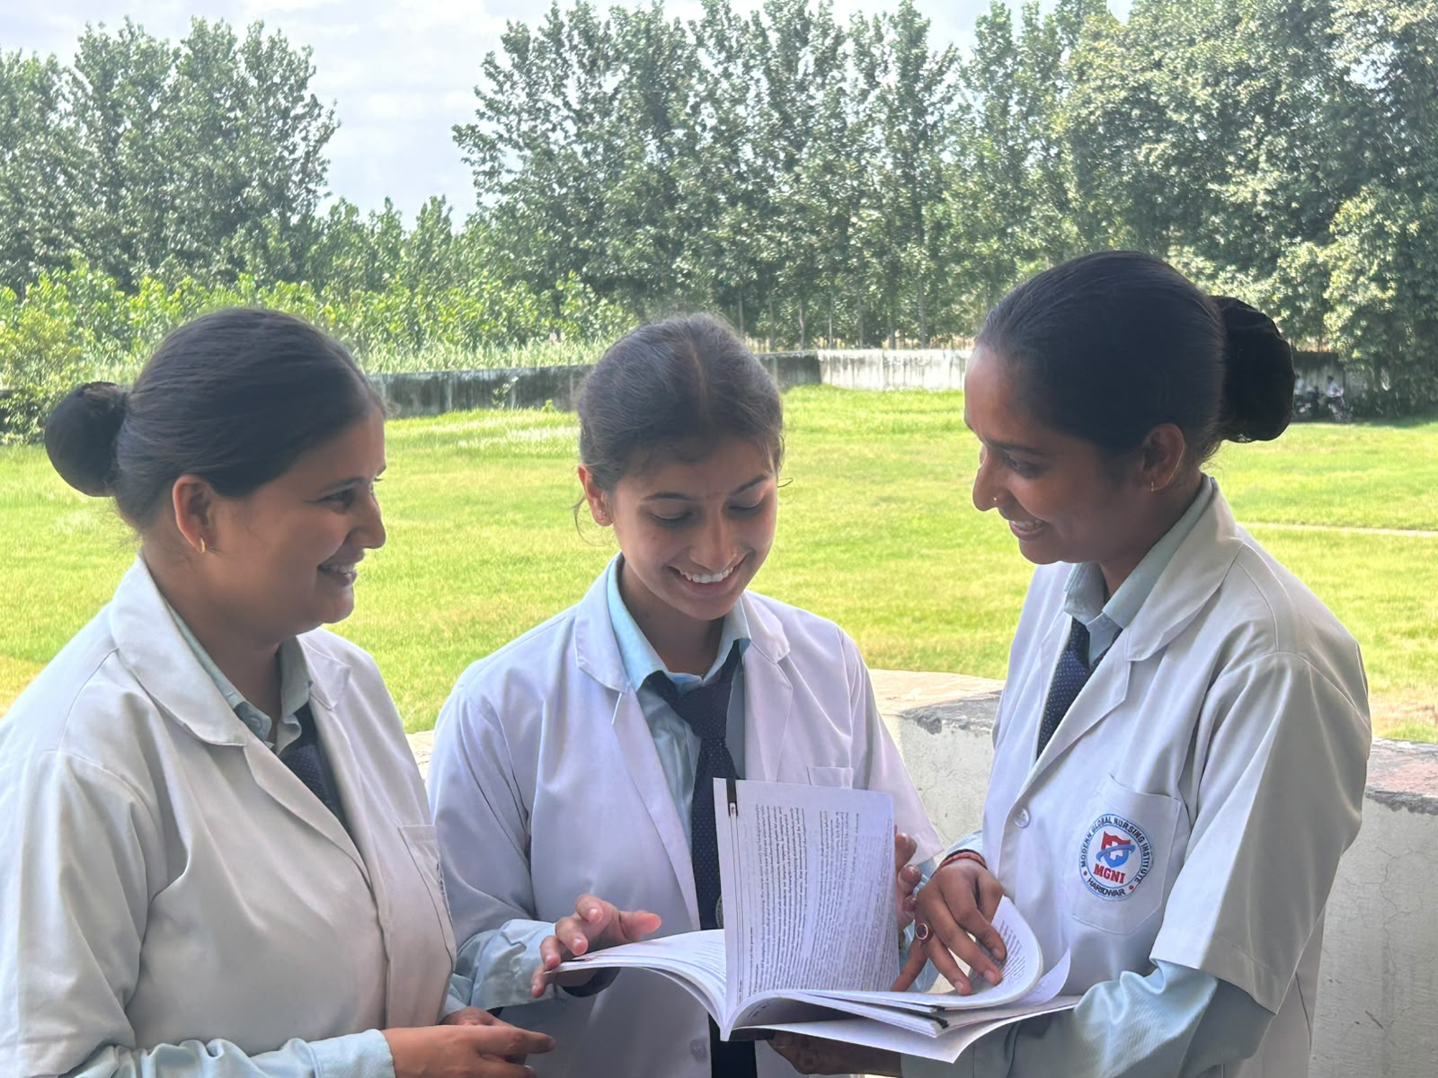

Slide 7
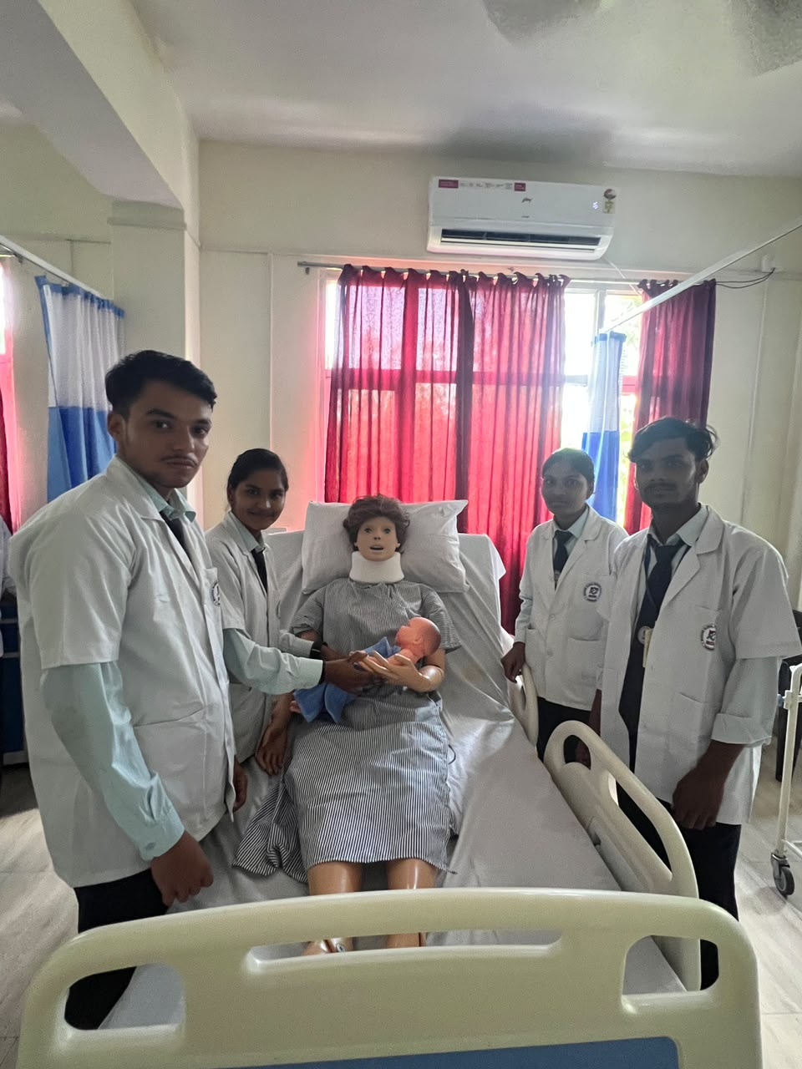
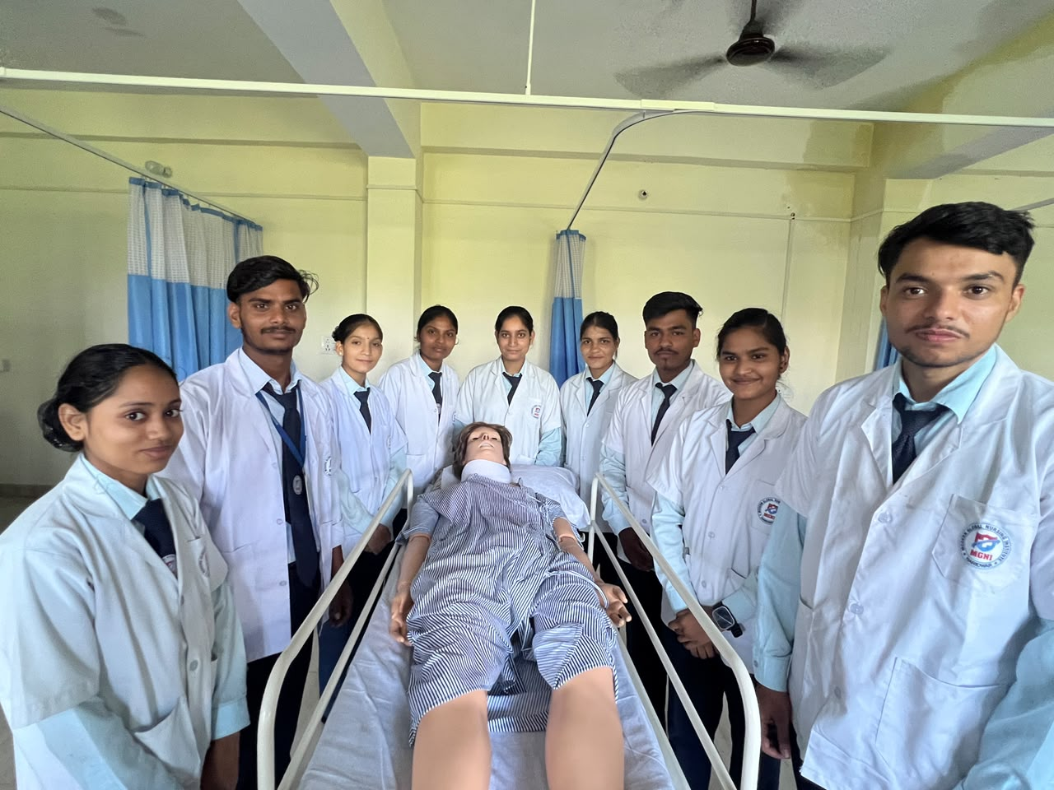
When you're a NURSE, you know that every day you will touch a life or a life will touch YOURS

Slide 8

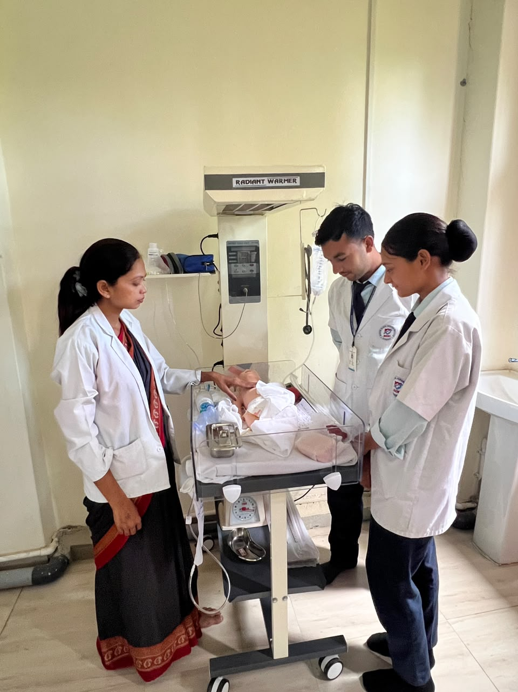

Slide 9
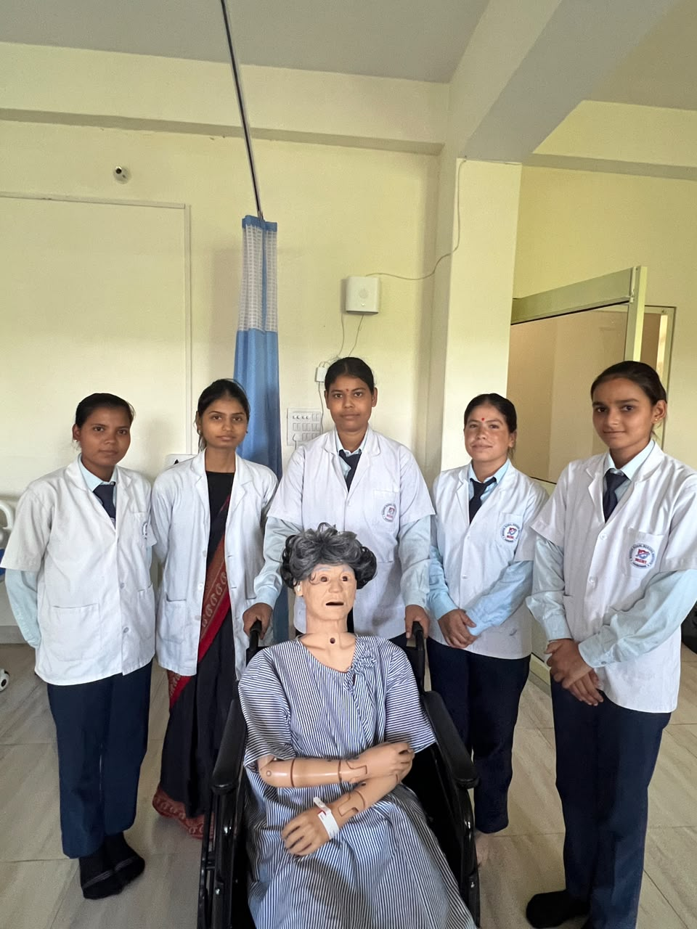
FUNDAMENTAL LAB

Slide 10
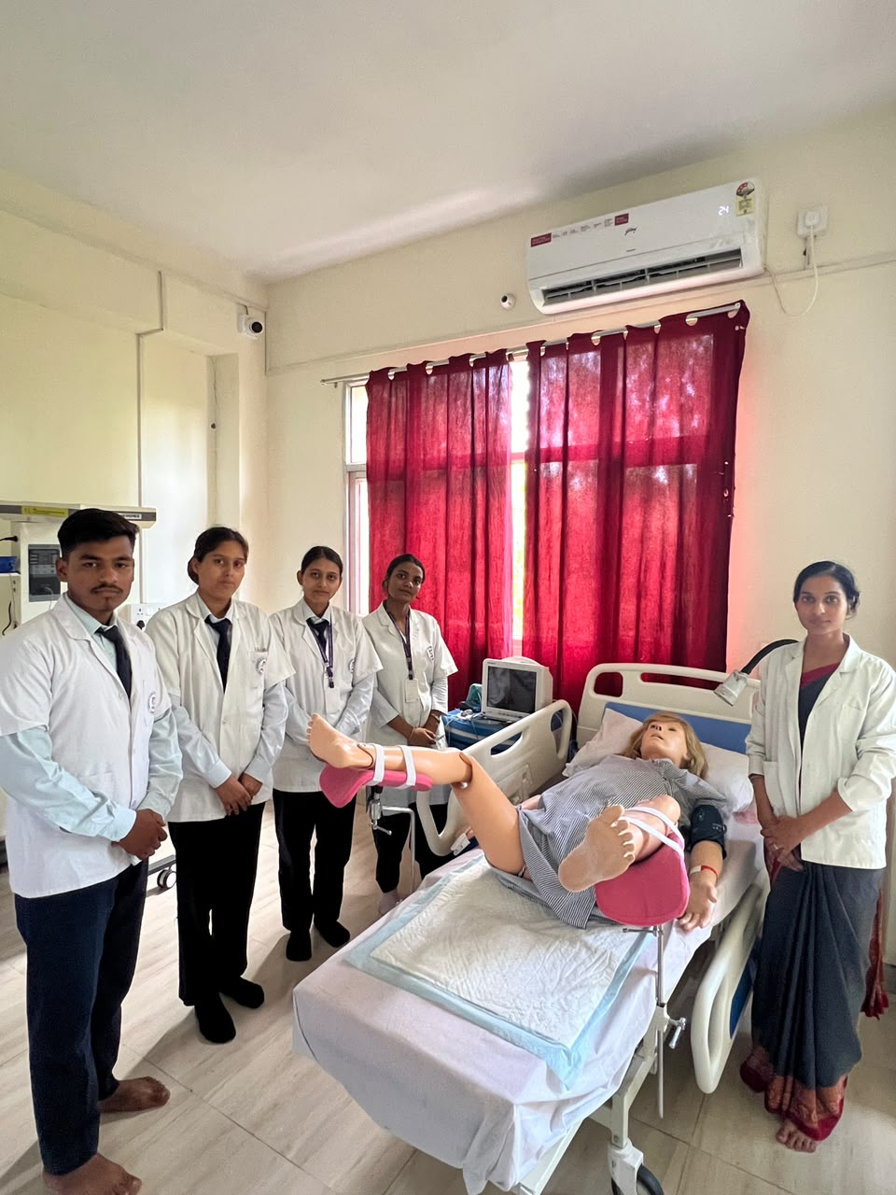
I DROPPED CHEMISTRY.
I PRACTICALLY BLEW UP THE LAB IN COLLEGE

Slide 11
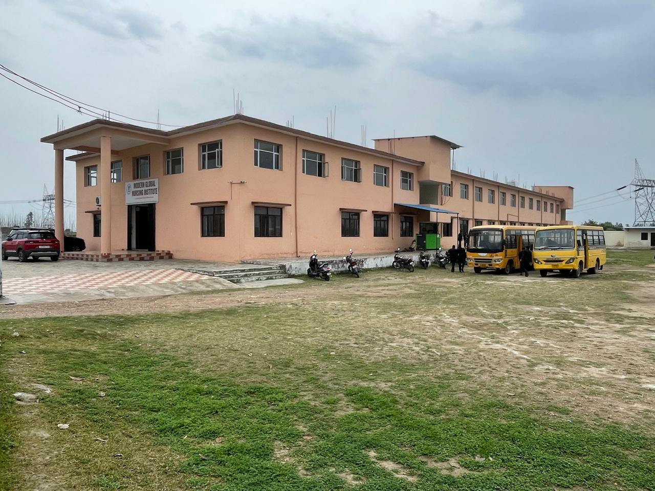
Modern Global Nursing Institute

Slide 12
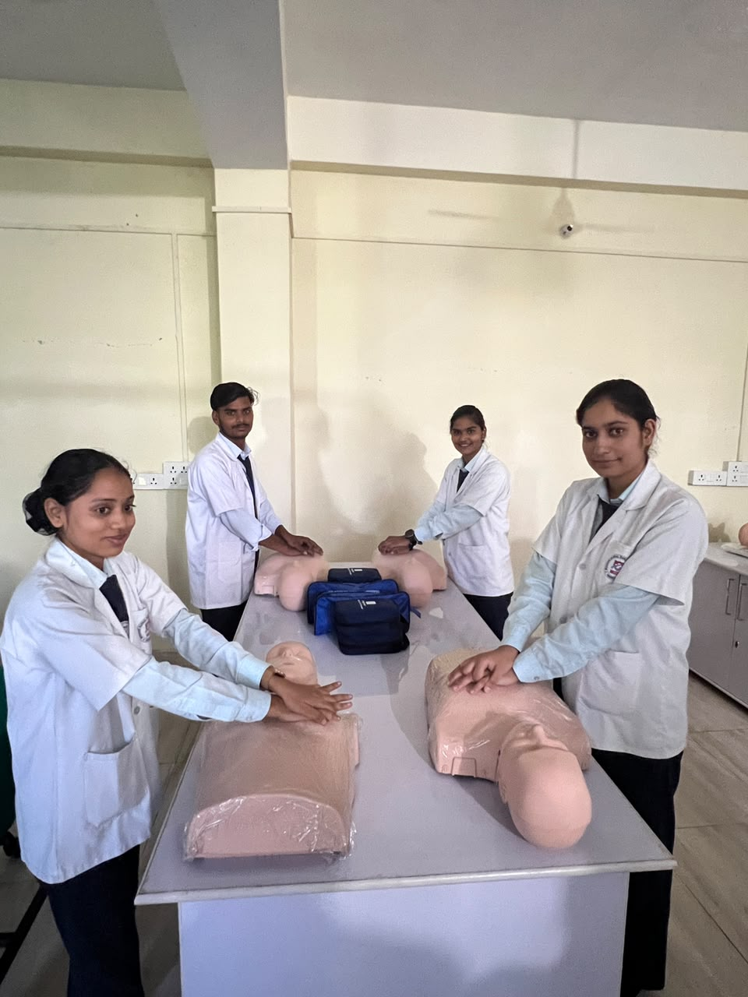
TAKE SOME TIME TO LEARN
FIRST AID AND CPR. IT SAVES LIVES, AND IT WORKS

Slide 13
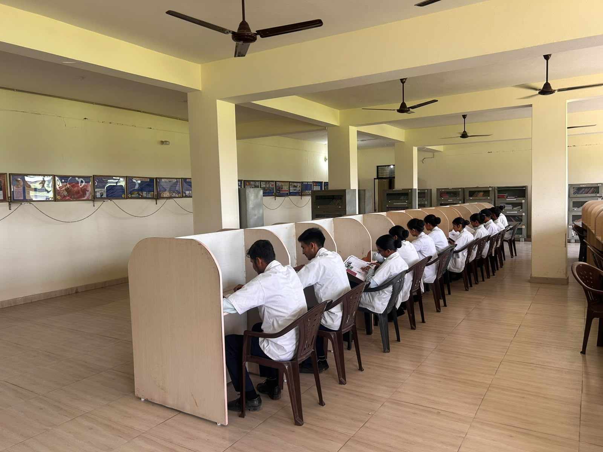
LIBRARY

Slide 14
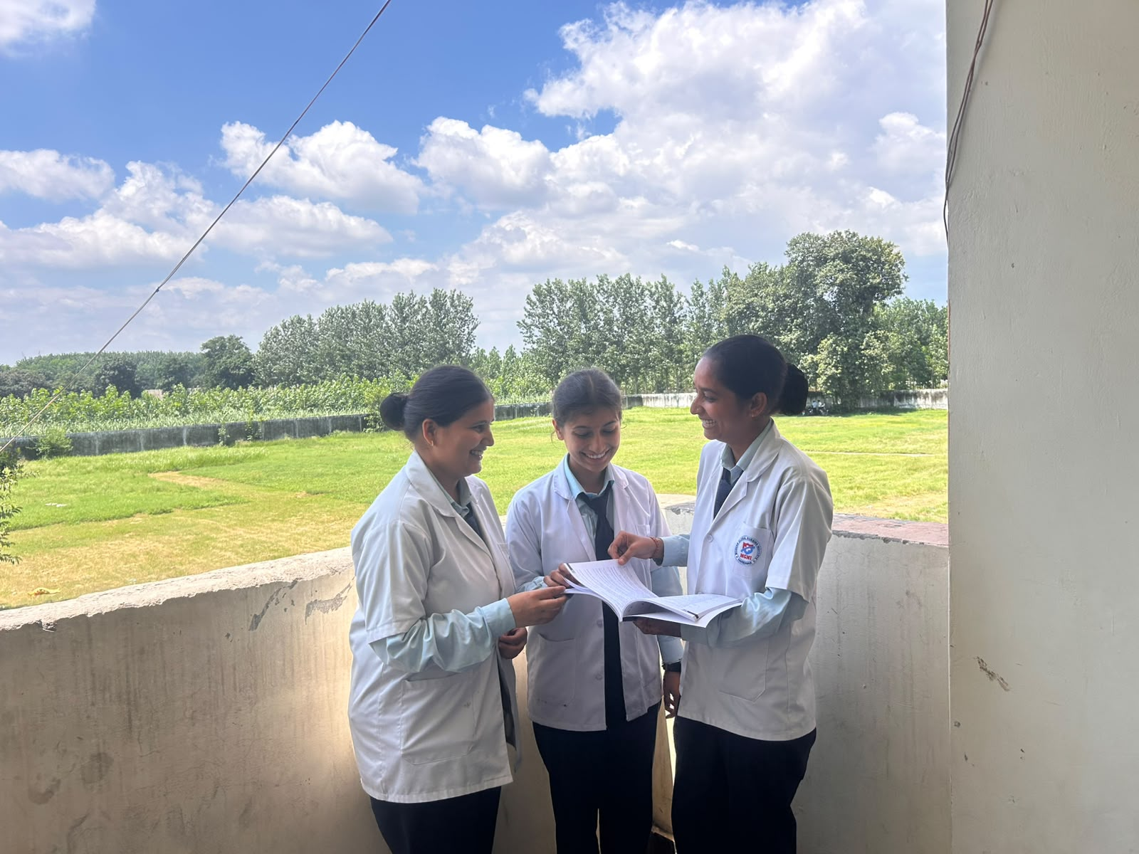
LET US NEVER CONSIDER OURSELVES FINISHED NURSES….
WE MUST BE LEARNING ALL OF OUR LIVES..

Slide 15
Nursing Course Fees Details
B.Sc. Nursing:- 4Year Program
(Intermediate Passed With science (PCB) & minimum aggregate of 45% marks)
1st Year – 90,000/-+Exam Fees
2nd Year – 90,000/-+Exam Fees
3rd Year – 90,000/-+Exam Fees
4th Year – 90,000/-+Exam Fees
GNM:- 3Year Program
(Intermediate Passed with English and minimum of 40% aggregate marks)
1st Year – 75,000/-+Exam Fees
2nd Year – 65,000/-+Exam Fees
3rd Year – 65,000/-+Exam Fees
P.B.B.Sc.:- 2Year Program
(GNM Passed Student)
1st Year – 90,000/-+Exam Fees
2nd Year – 90,000/-+Exam Fees
Hostel Fees (Only for Girls)- 5,500/- per months

Slide 16


